Slide 1
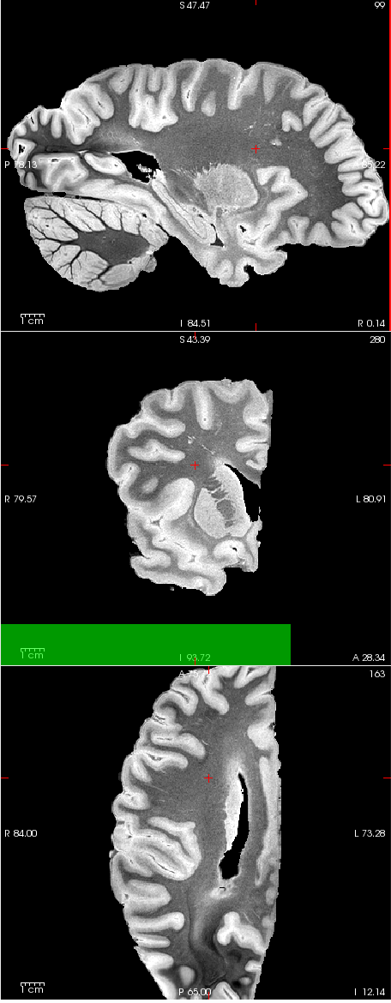
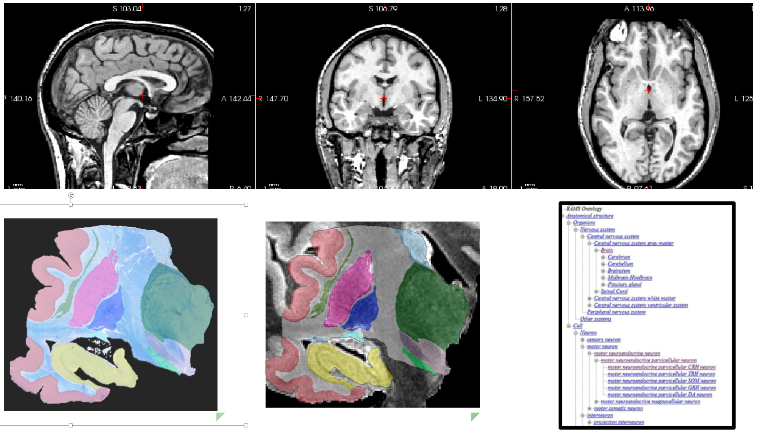


Show labels
Label transparency
Channel:
Current label:
N/A
Notes:
Let’s say we start from here. Note that the MRI planes are consistent with the position of the cursor, i.e., the cursor on x,y coordinates in one view means that you’re looking at slices x and y in the other 2 views.
Also: I’ve left the main panel blank for now, but we could also initialize it to the corresponding block.
Now, let’s pretend the user clicks on the spot marked by the arrow (go to the next slide)

Slide 2
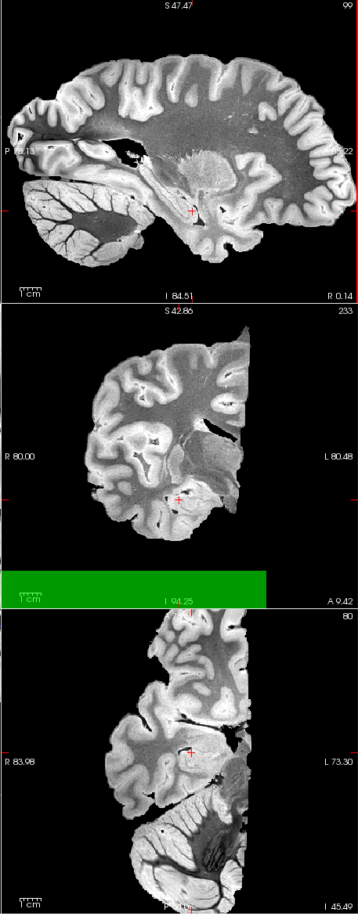
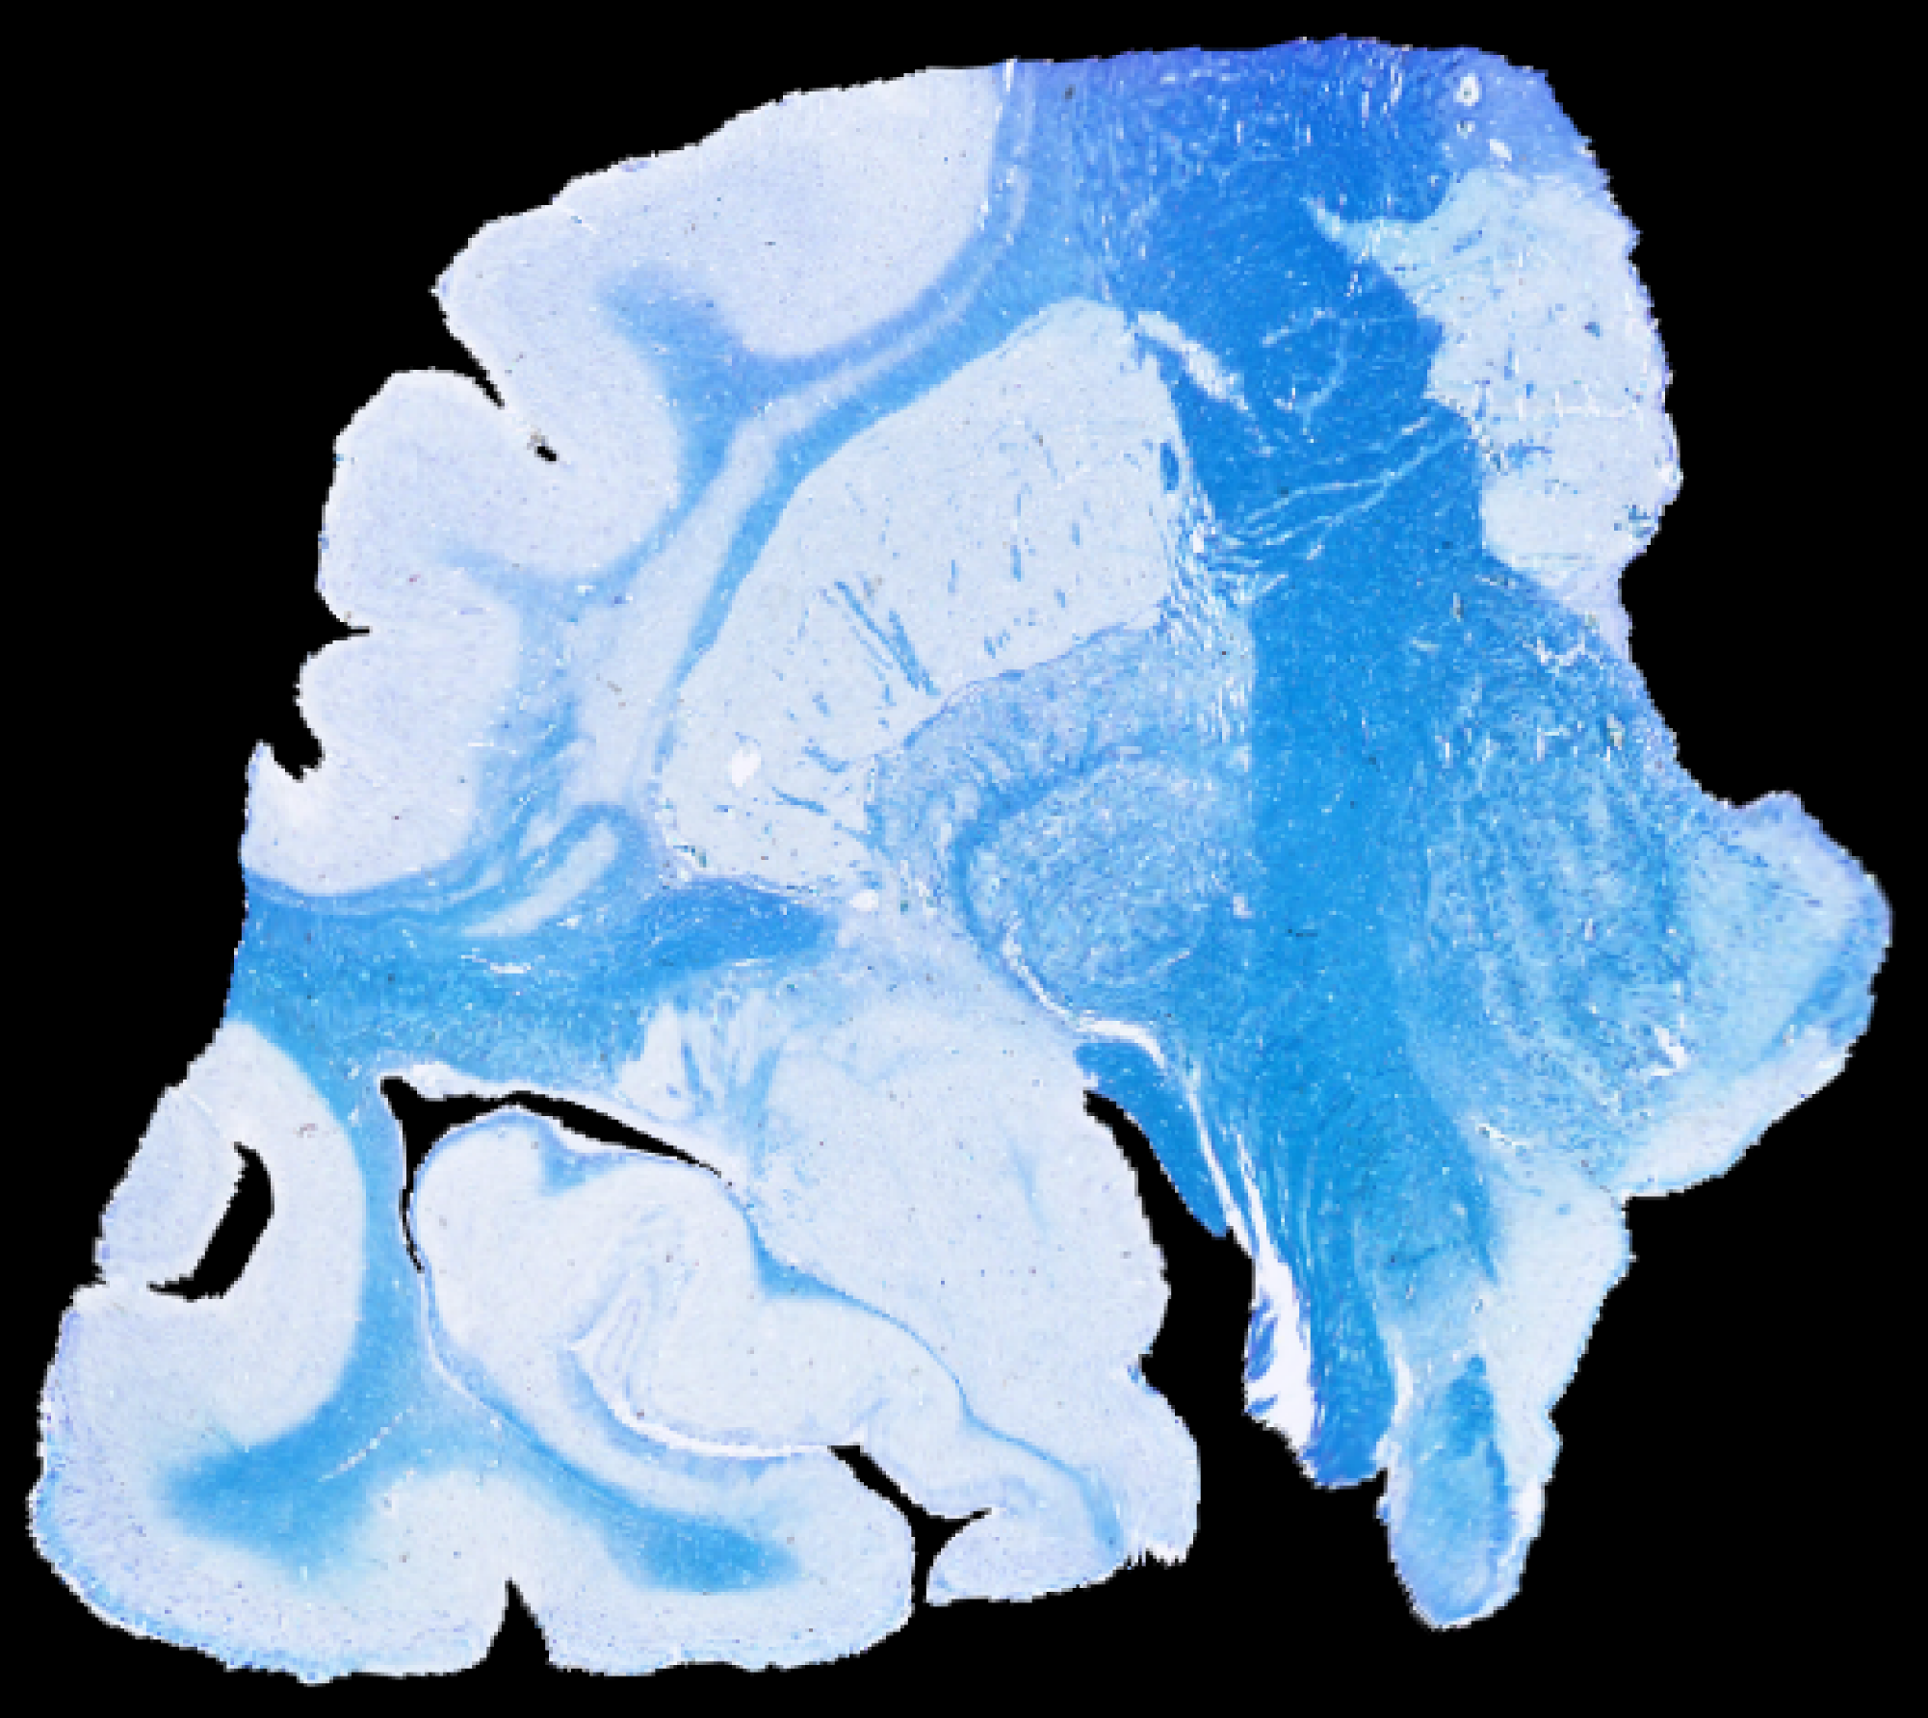

Show labels
Label transparency
Channel:
LFB
Current label:
Anterior CA1
Notes:
So once the user has clicked, a bunch of things happens
The cursor moves in the sagittal view of the mri (where the user clicked)
The coronal and axial views of the mri synchronize.
The corresponding block of histology pops in the main panel, with the cursor on the corresponding anatomical landmark (which is given by the corresponding matrix)
The label of the pixel under the cursor is displayed, along with its corresponding color (pointed by red arrow). The color won’t be important until we overlay the labels later on. By default, we load the LFB histology. But you can also flip across the different image channels of the block (see next slide)

Slide 3
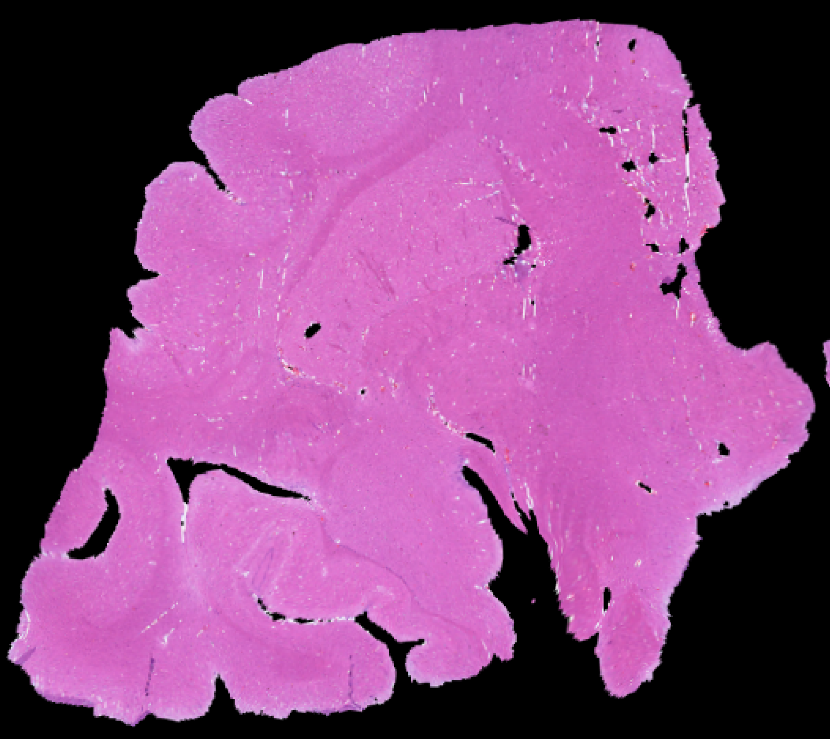
Show labels
Label transparency
Channel:
H & E
Current label:
Anterior CA1
Notes:
You can flip between the different image channels of the block using the drop-down menu (pointed by the arrow). For example, we could switch to the H&E stain

Slide 4
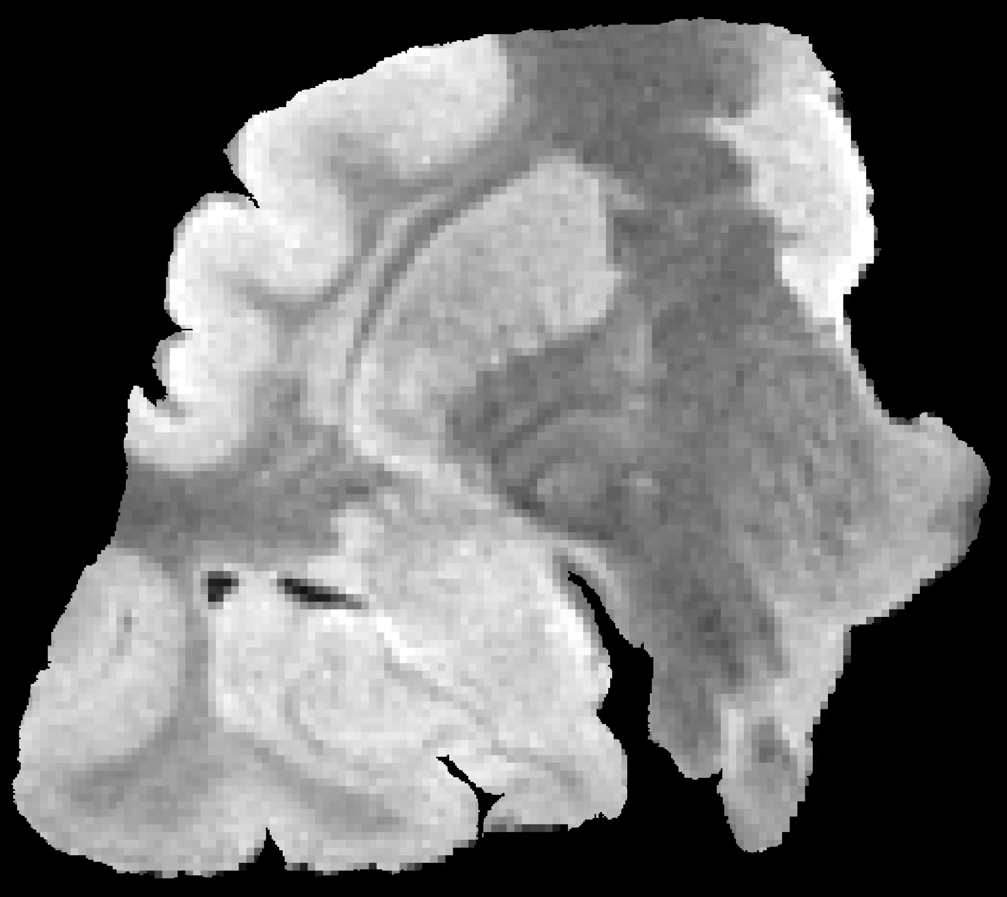
Show labels
Label transparency
Channel:
MRI
Current label:
Anterior CA1
Notes:
You can flip between the different image channels of the block (in this case, resampled MRI).
Note that it doesn’t look exactly as the coronal plane in the left (pointed by the arrow), because the block is a bit oblique. It is pretty similar, though.

Slide 5
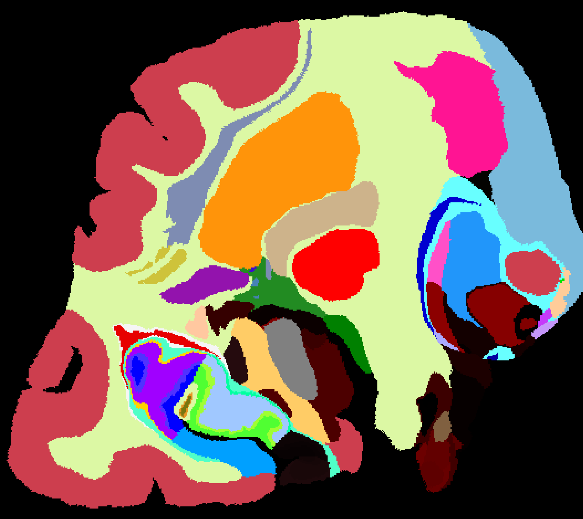
X
Show labels
Label transparency
Channel:
MRI
Current label:
Anterior CA1
Notes:
Now the user decided to overlay the labels by checking the “show labels” box (red arrow). Transparency is adjustable with a slider (blue arrow). The color of the overlaid labels is of course consistent with the color shown in the “Current Label” panel.

Slide 6
X
Show labels
Label transparency
Channel:
LFB
Current label:
Anterior CA1
Notes:
You can also overlay the labels on the other channels, eg, the LFB.

Slide 7
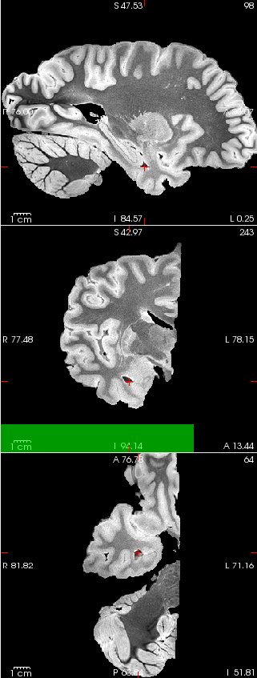

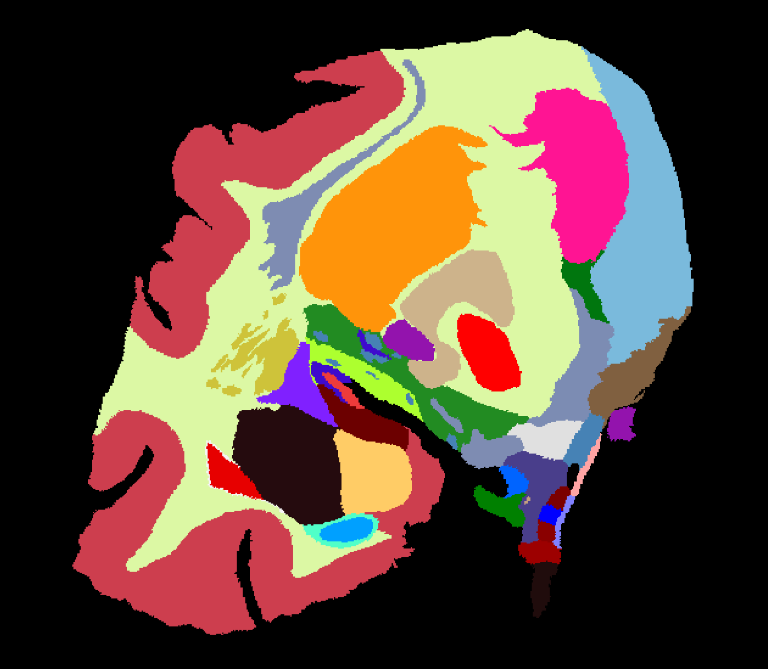
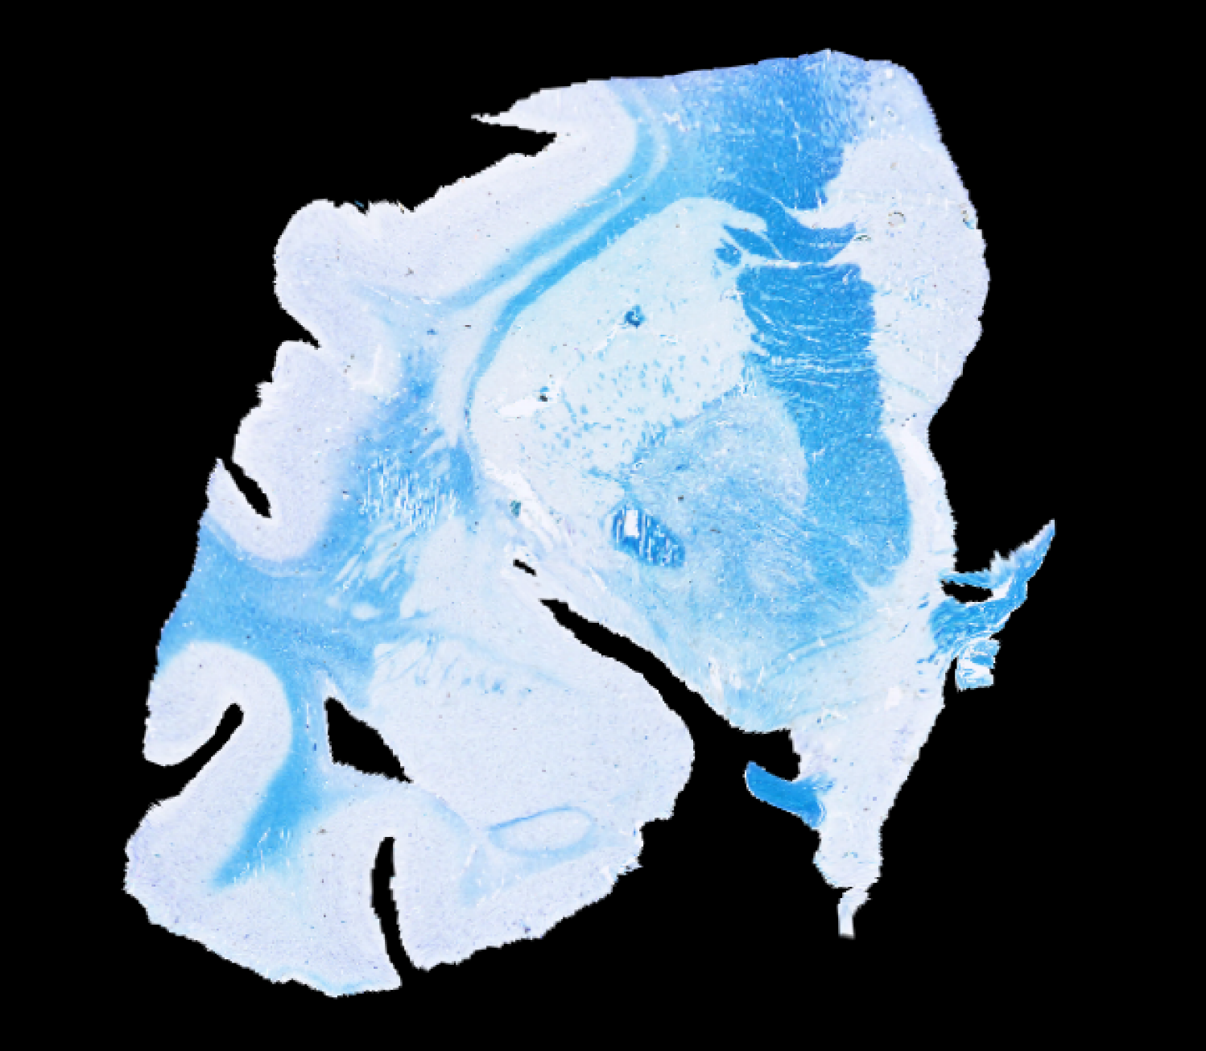
X
Show labels
Label transparency
Channel:
LFB
Current label:
Inf Lat ventricle
Notes:
You can use the slider (pointed by arrow) to navigate to a different slice in the block. Note that the MRI panels on the left synchronize accordingly. The ”Current label” panel also synchronizes.

Slide 8
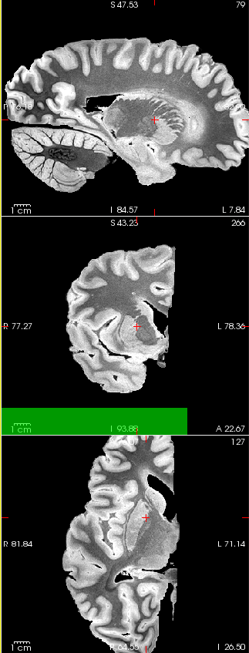
X
Show labels
Label transparency
Channel:
LFB
Current label:
Putamen
Notes:
You can also navigate the histology by clicking on the histology image. That will move the cursor (crosshair), update the current label, and also synchronize the MRI on the left.

Slide 9
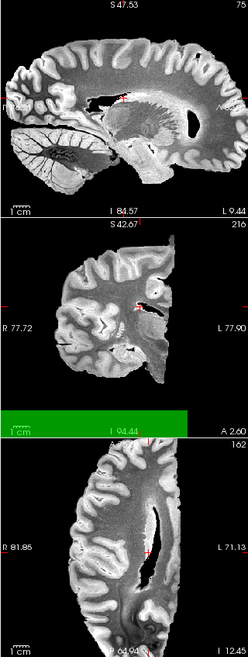
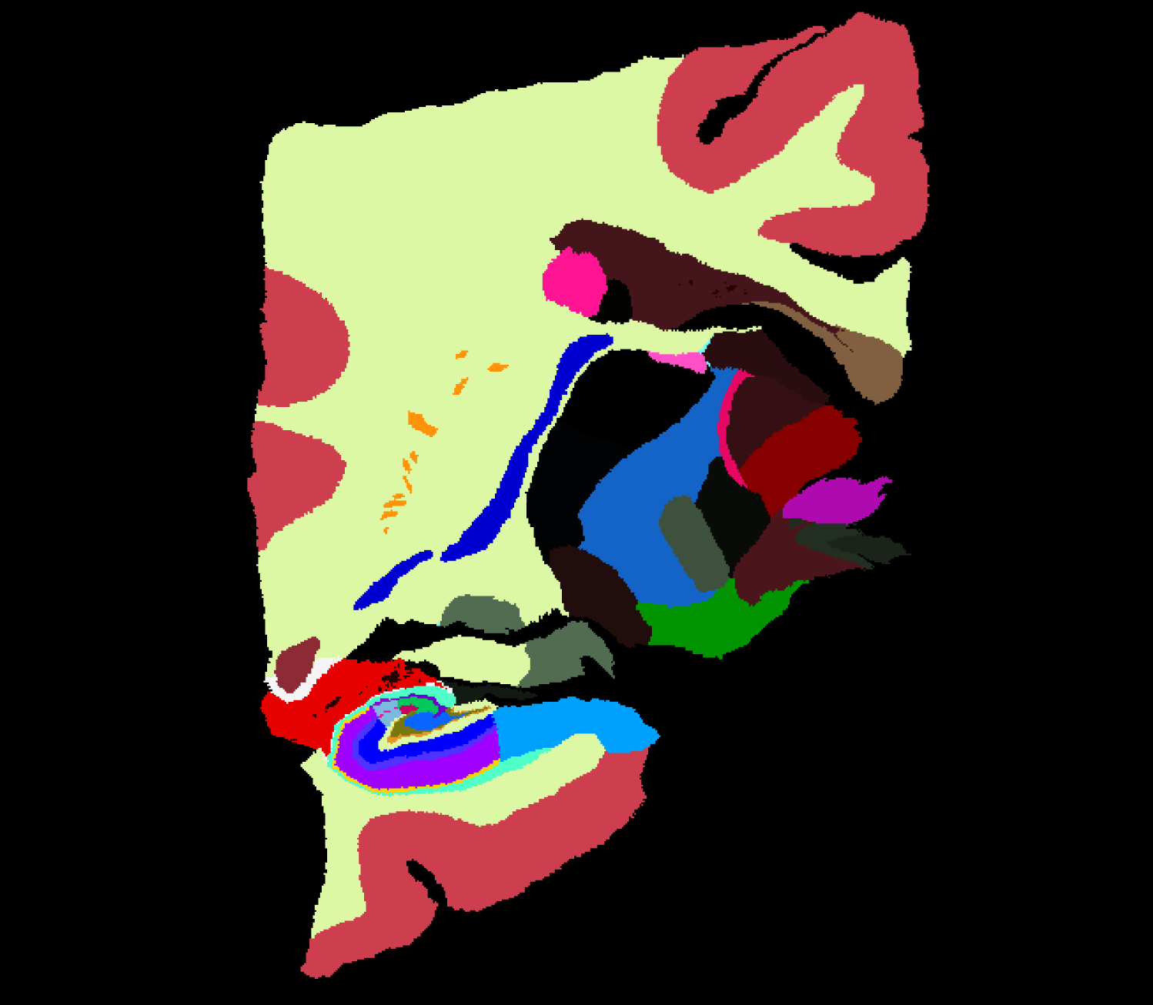
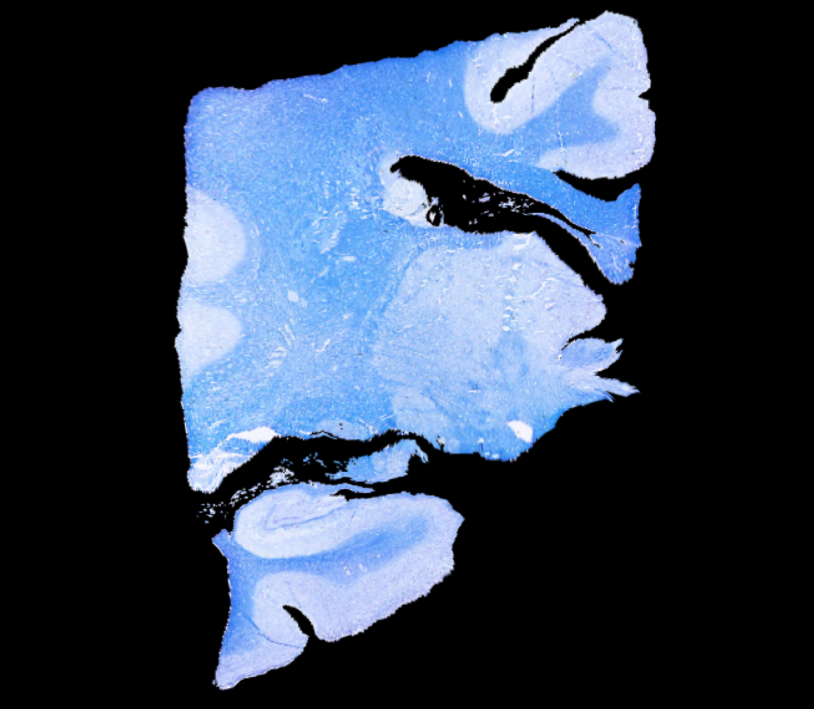
X
Show labels
Label transparency
Channel:
LFB
Current label:
Post caudate
Notes:
One final way of navigating is clicking on the name of a structure in the ontology tree on the right (pointed by the arrow). This will navigate straight to the centroid of the structure one has clicked on, both on the MRI and on the histology, and update the ”Current label” panel. In this example, we have clicked on ”Posterior caudate”

